Slide 1
Caring for Those Who Care for Others
Jennifer Battle, MSW, Director of Access
The Harris Center for Mental Health and IDD

Slide 2
Objective 1 - Recognize signs and symptoms of compassion fatigue and burnout
Objective 2 – Identify ways to ensure resiliency and compassion satisfaction
Objective 3 – Identify self-care and self-compassion strategies.

Slide 3
The Harris Center at a Glance
Neuropsychiatric Center
Four Behavioral Clinics
52 School-based co-locations
Crisis Residential Unit (18 beds)
Judge Ed Emmett Mental Health Diversion Center
P.E.E.R.S. House
Law Enforcement Collaborations
Early Childhood Intervention
Day Habilitation for Persons with IDD
Crisis Call Diversion
80% of the people we serve have household incomes at or below the Federal Poverty Level.

Slide 4
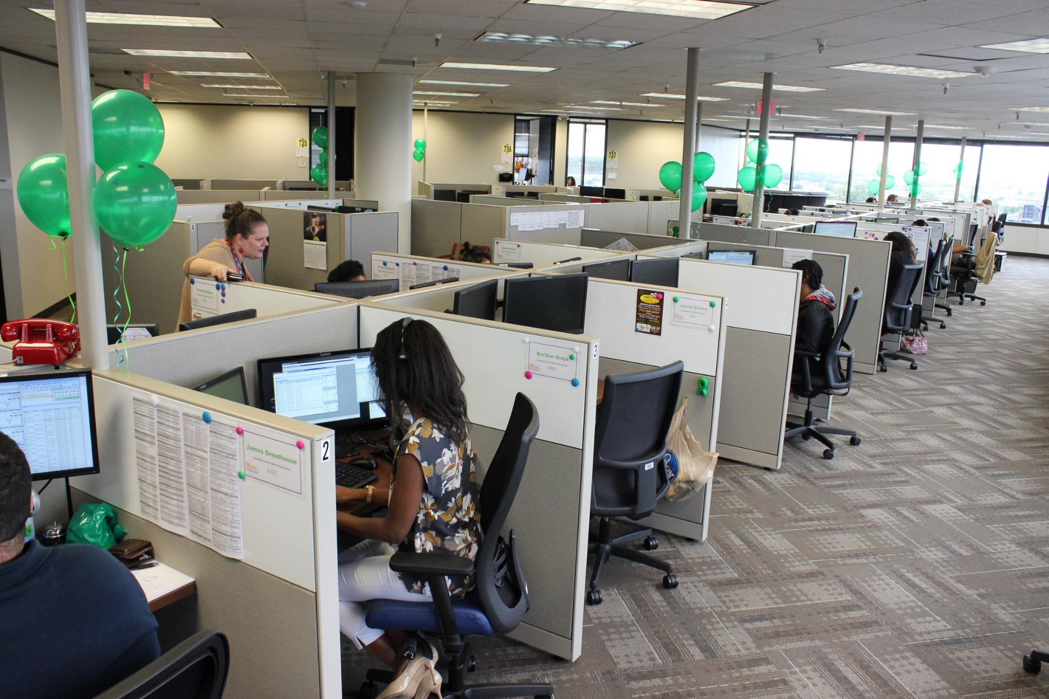
The Access Center
Available 24/7/365
Answers approx. 23,000 calls a month for 36 Texas counties
43 full time degreed Crisis Line Specialists
10 full time Access Line Specialists
15 full time COVID Line Responders
Serves as the National Suicide Prevention Lifeline responder for 20 Texas counties

Slide 5
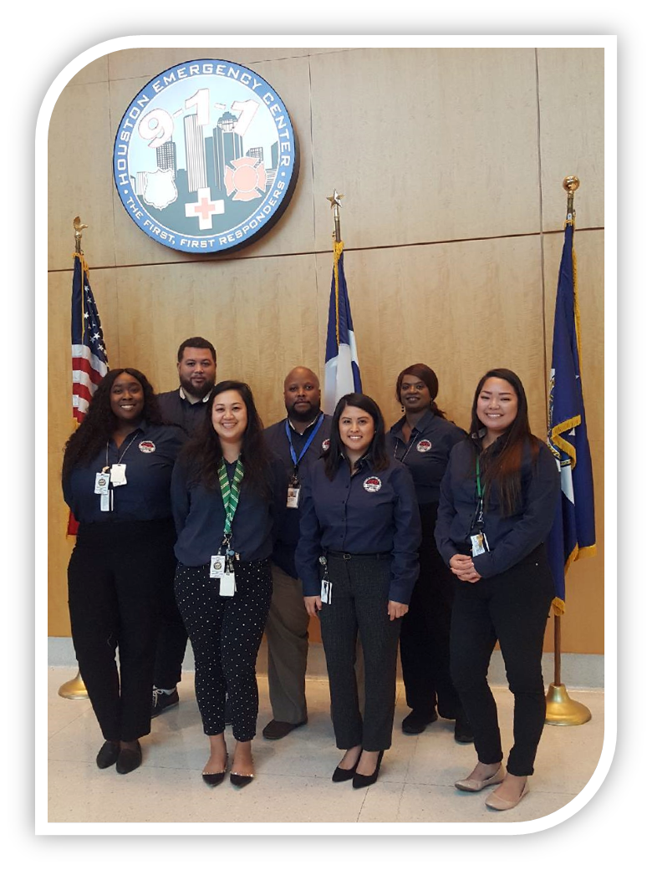
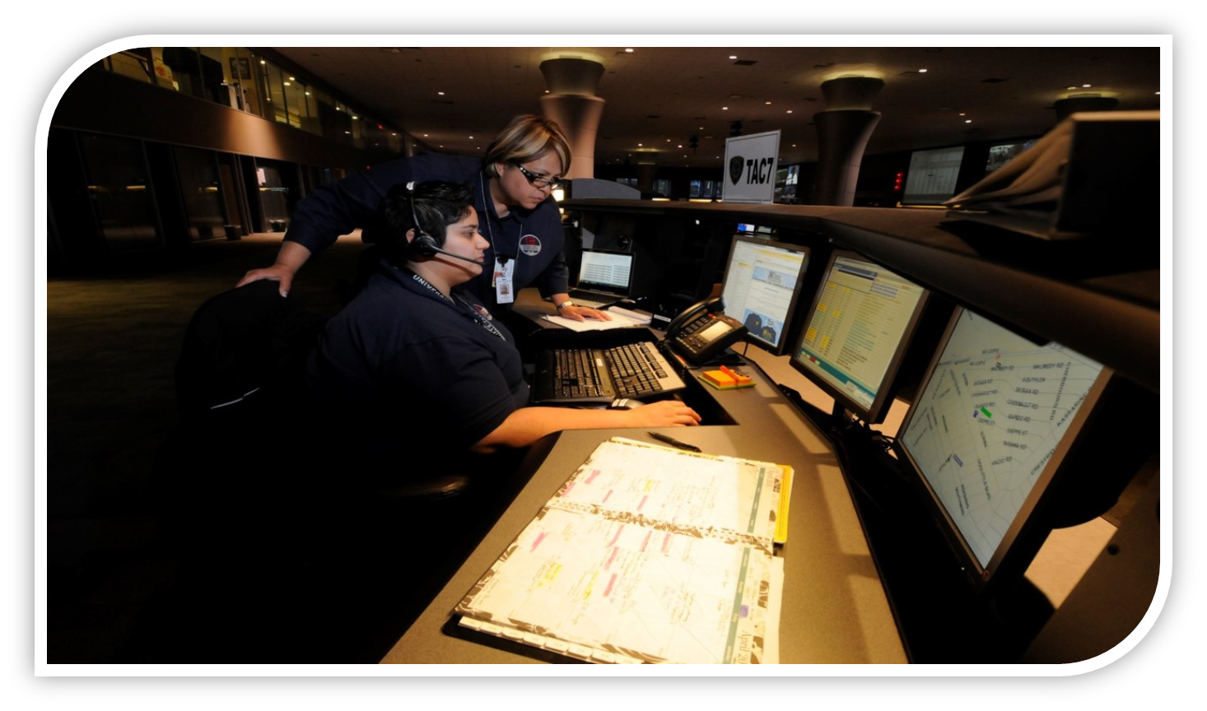
The 911 Crisis Call Diversion Team

Slide 6
Are you feeling…
More tired than usual
Like you’re not able to fall or stay asleep
Lack of interest in things you usually enjoy
Intense loneliness
Irritable
Unable to focus
Forgetful

Slide 7
You’re not alone!
In a recent Kaiser Family Foundation poll, nearly half (45%) of adults in the United States reported that their mental health has been negatively impacted due to worry and stress over the virus. As the pandemic wears on, it is likely the mental health burden will increase.
https://www.kff.org/coronavirus-covid-19/issue-brief/the-implications-of-covid-19-for-mental-health-and-substance-use

Slide 8
This is in addition to the regular stress…
Stress of the calls
Long shifts
Too many shifts
High call volume
Too few people on the job
Dealing with difficult people or patients
Facing risks that lead to anxiety and depression
Feeling they have to appear invincible
Stress from PTSD
https://armorupnow.org/2018/06/07/handling-stress-and-burnout-as-a-first-responder/

Slide 9
Signs that you or a colleague may be feeling distressed
Emotional reactions
anxiety, fear, powerlessness, helplessness, worry, anger
Physical or somatic reactions
nausea, light headedness, increase in BP, headaches, stomach aches, increase in heart rate and respiration or holding breath

Slide 10
Behavioral reactions
crying, uncooperative, argumentative, unresponsive, restlessness
Cognitive reactions
memory impairment or forgetfulness, inability to give adequate history

Slide 11
Without intervention these symptoms can lead to:
Burnout
Emotional Exhaustion
Diminished Caring
Profound Sense of Demoralization
Secondary/Vicarious Trauma

Slide 12
https://www.acep.org/corona/covid-19-field-guide/personal-well-being-and-resilience/burnout-self-care-and-covid-19-exposure-for-first-responders/

Slide 13
Prevention
Connection to mission
Focus on resiliency
Wellness/Self-Compassion

Slide 14
Resilience
Resilience is the process of adapting well in the face of adversity, trauma, tragedy, threats or significant sources of stress.
Resilience is not a trait that people either have or do not have. It involves behaviors, thoughts and actions that can be learned and developed in anyone.

Slide 15
Factors that contribute to resilience
Having caring and supportive relationships.
The capacity to make realistic plans and take steps to carry them out.
A positive view of yourself and confidence in your strengths and abilities.
Skills in communication and problem solving.
The capacity to manage strong feelings and impulses.
http://www.apa.org/helpcenter/road-resilience.aspx

Slide 16
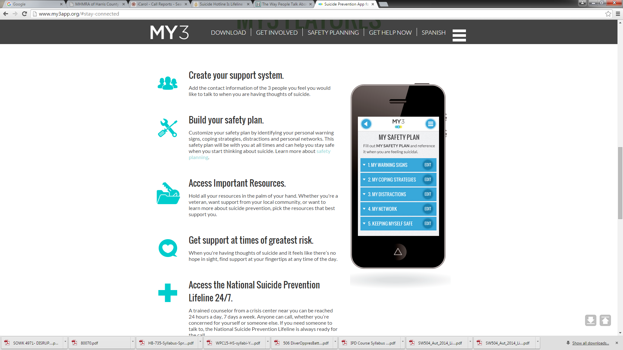

Slide 17
Self Compassion

Slide 18
Responder Wellness Techniques
Limit working hours to no longer than 12-hour shifts.
Work in teams and limit amount of time working alone.
Write in a journal.
Talk to family, friends, supervisors, and teammates about your feelings and experiences.
Practice breathing and relaxation techniques.
Maintain a healthy diet and get adequate sleep and exercise.
Know that it is okay to draw boundaries and say “no.”
Avoid or limit caffeine and use of alcohol.
https://emergency.cdc.gov/coping/responders.asp

Slide 19
It is important to remind yourself:
It is not selfish to take breaks.
The needs of survivors are not more important than your own needs and well-being.
Working all of the time does not mean you will make your best contribution.
There are other people who can help in the response.

Slide 20
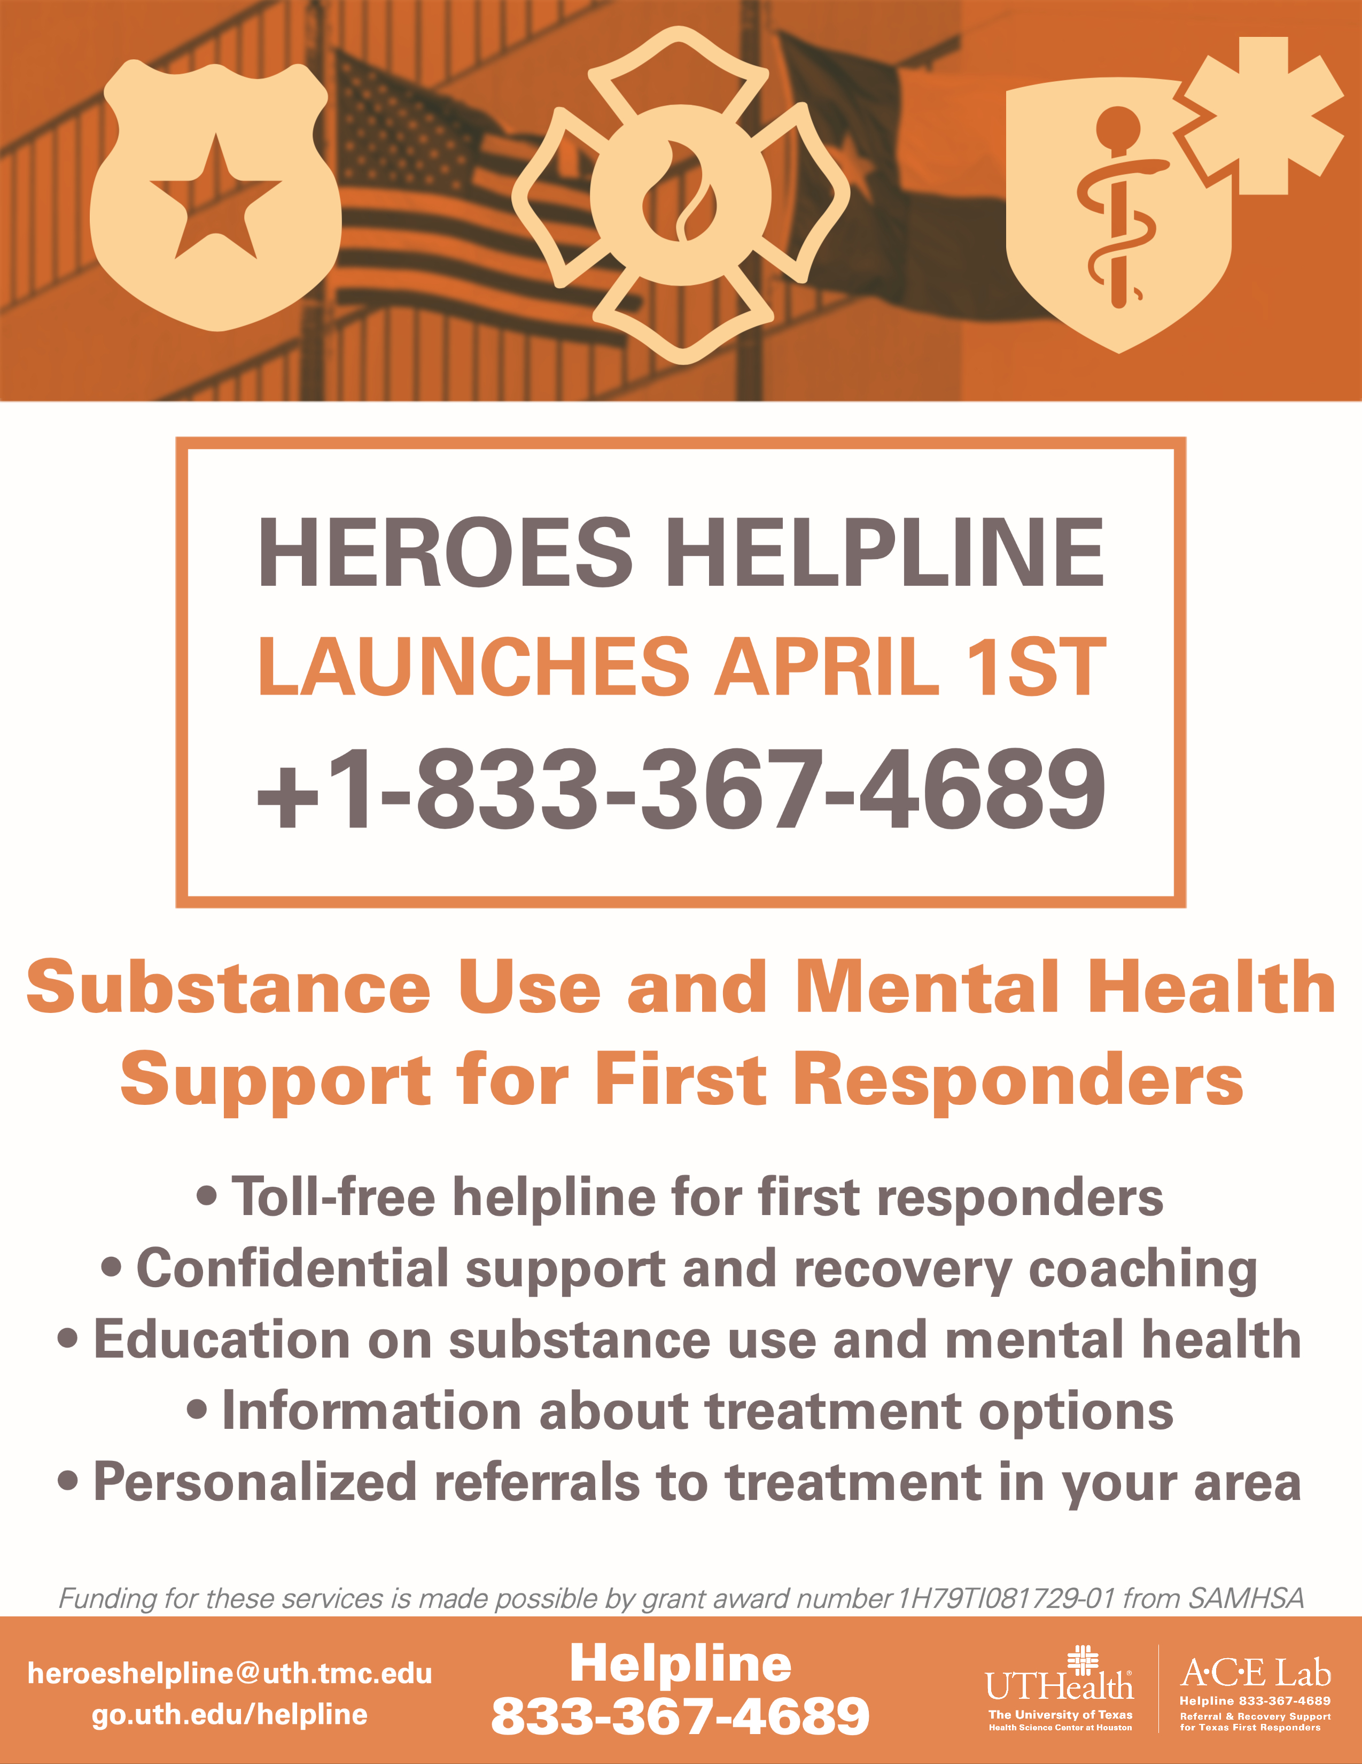

Slide 21
This is for YOU!!!
Free virtual support groups for Frontline workers.

Slide 22
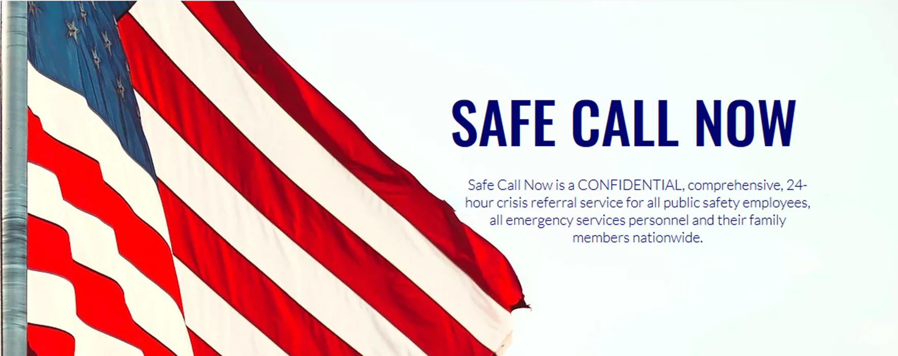
24 HOUR HOTLINE 206-459-3020

Slide 23
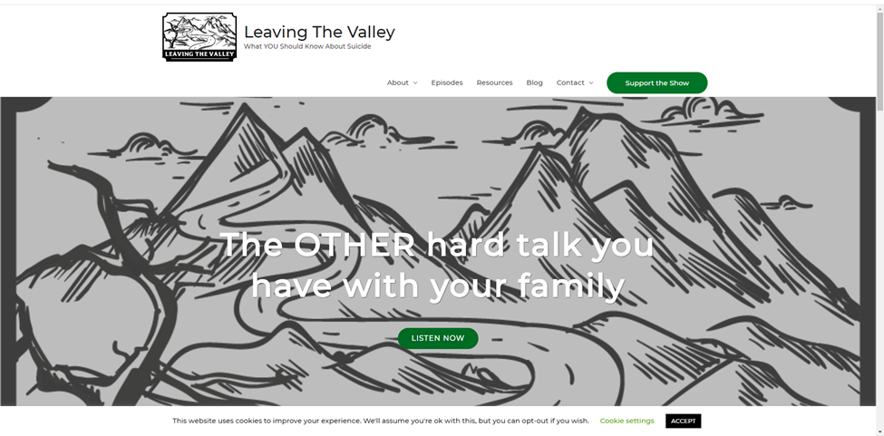
Podcast hosted by Dr. Sam Buser of the Houston Fire Department and his daughter

Slide 24
Thank you for everything you do every day to help keep Texas safe and healthy.
You are appreciated.

Slide 25
Jennifer Battle, MSW
The Harris Center for Mental Health and IDD
713-970-8240 (direct)
713-970-7000 (24 hour Crisis Line)
Jennifer.Battle@theharriscenter.org

