Slide 1
NFPA 3000
Standard for an Active Shooter/Hostile Event Response Program

Slide 2
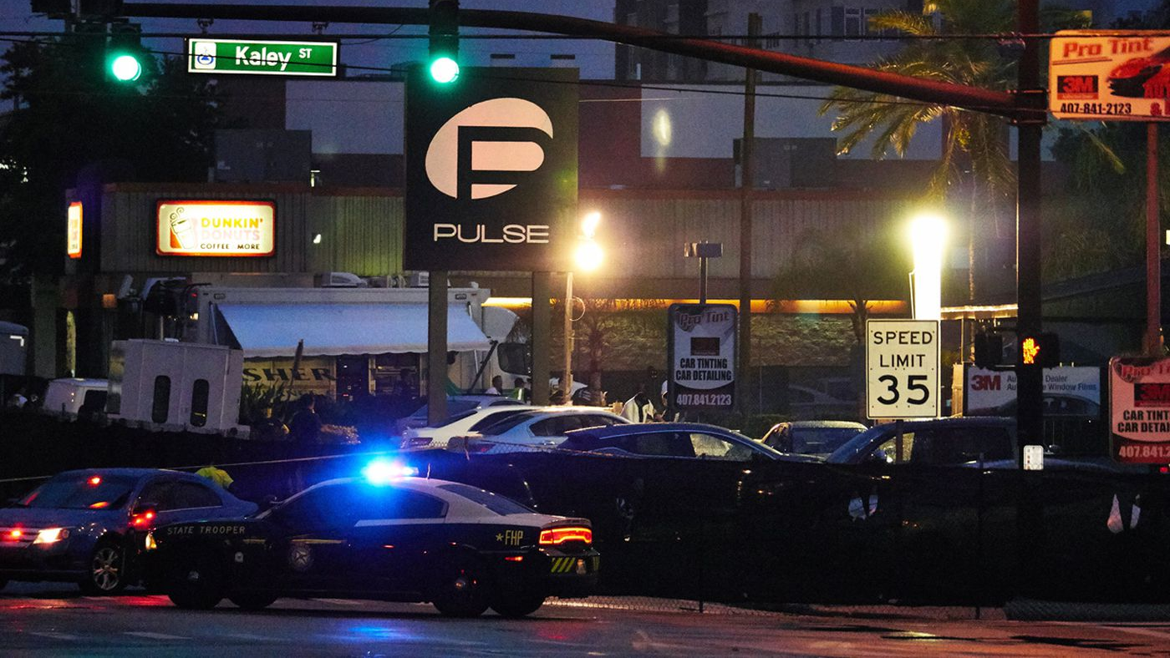
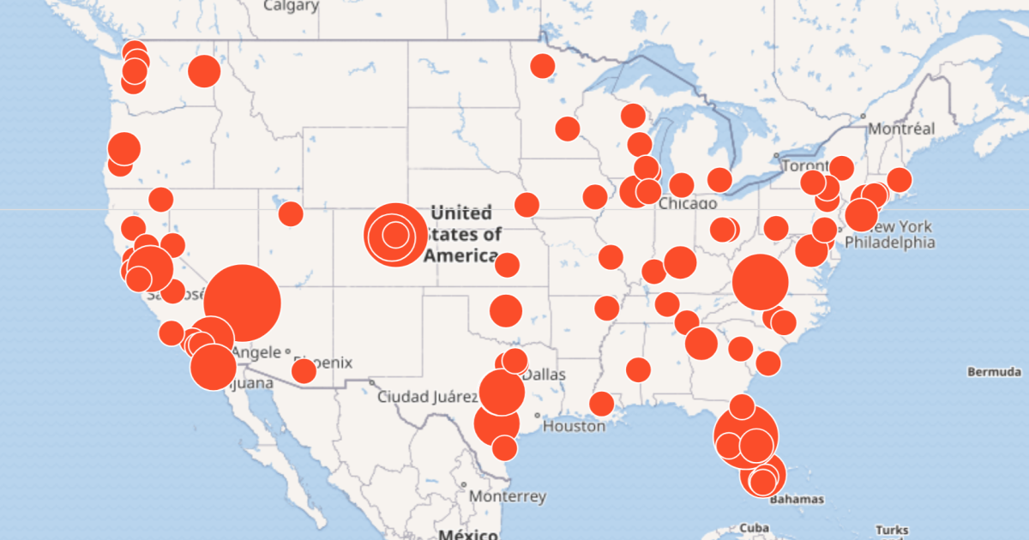
Active Shooter Incidents|2000-2017
INCIDENTS
250
CASUALTIES
2,217
KILLED
799
WOUNDED
1,148
Map provided by Mother Jones Investigations
Notes:
We all know these incidents are occurring and appear to be increasing in frequency. The most recent data from the FBI supports that. In a recent FBI report on active shooter incidents in the U.S., they found (www.fbi.gov):
In 250 incidents, 799 people were killed and 1,418 were wounded.
And active shooter incidents are happening more often:
First 7 years of the study show an average of 6.4 incidents annually
Last 7 years show 16.4 incidents annually
Despite this increasing trend, there is no standard guidance, so the development of NFPA 3000TM (PS) is in response to that need.

Slide 3
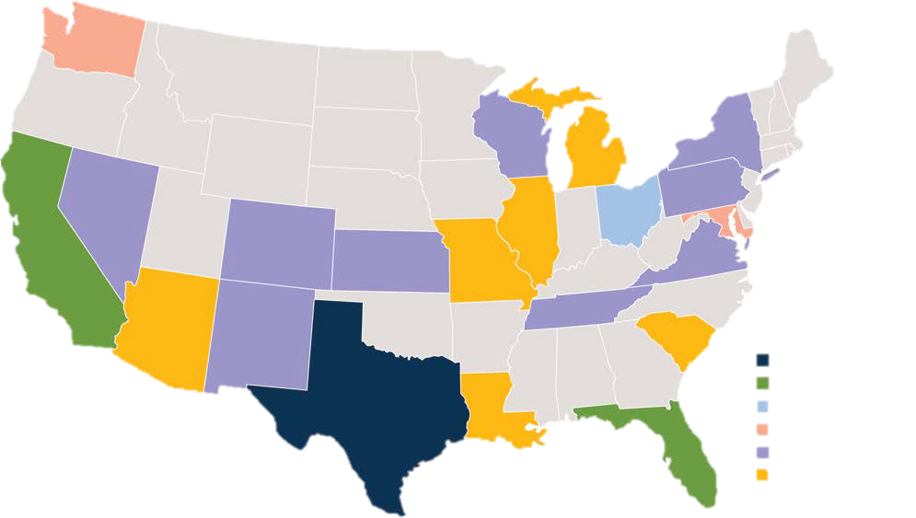
Active Shooter Incidents|2016-2017
INCIDENTS
50
CASUALTIES
943
KILLED
221
Six Incidents
Five Incidents
Four Incidents
Three Incidents
WOUNDED
Two Incidents
722
One Incident
Notes:
The latest FBI data shows the numbers continuing to rise, with 943 casualties (including people who were killed or wounded but excluding the shooters) in just those two years. And as the map shows, these incidents are happening all around the U.S. The perception that these are “big city problems” is wrong and dangerous. As an example, recently there were incidents in very small communities in TX, CA, and KY.

Slide 4
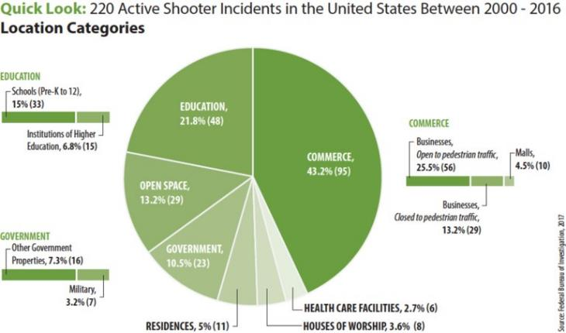
Incident Locations|CATEGORIES
2000-2016
INCIDENTS
220
COMMERCE
43.2%
EDUCATION
21.8%
Notes:
When you look at active shooter incidents, the breakdown of where these events are occurring might surprise you. Where do you think these events are happening?
This FBI chart shows that location category diversity and why there’s a need for whole communities to be actively engaged in preparing for these incidents.

Slide 5
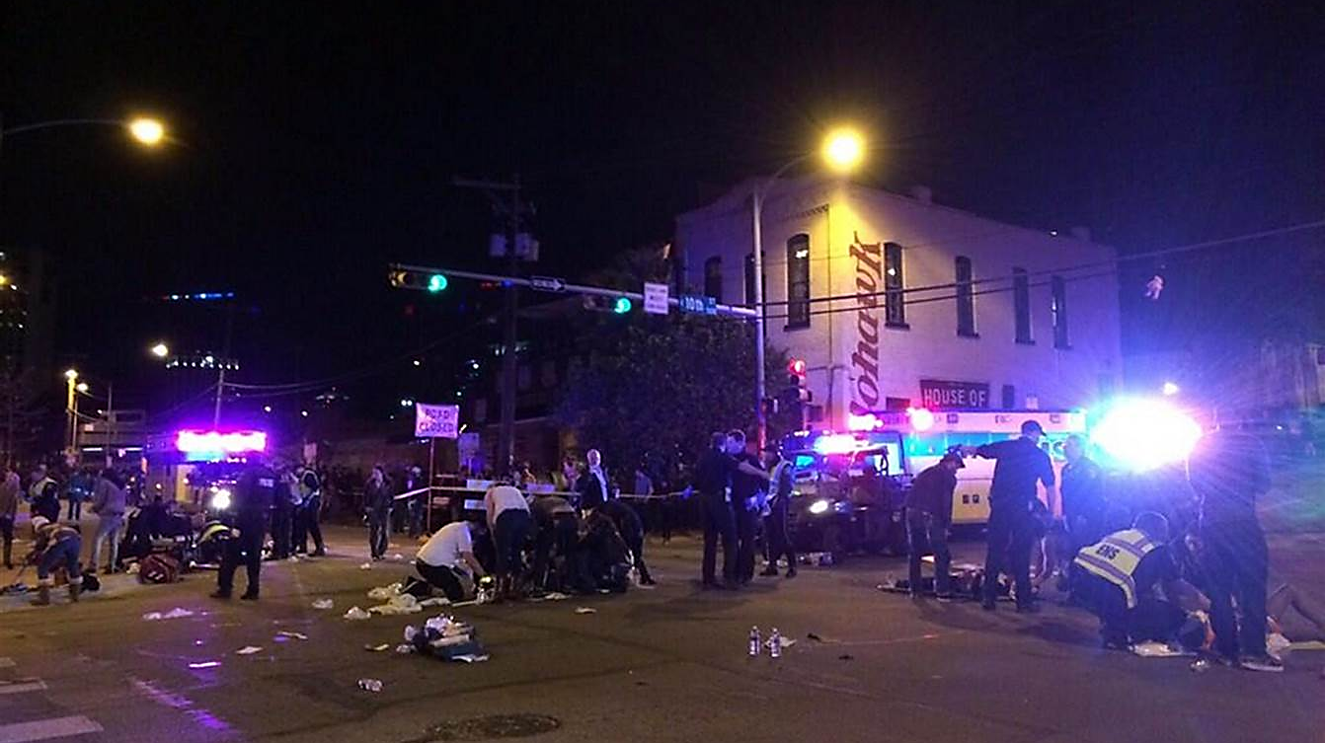
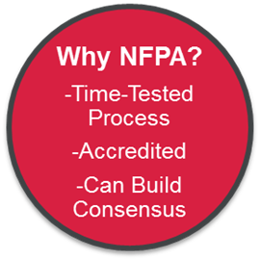
NFPA Involvement
PROVISIONAL CREATION
Standard created
REVIEW
Active Shooter Events and Issues
CREATION
SEEK INPUT
Formal, balanced, and broad technical committee
97% Positive Input for new standard
FORMATION
PROBLEM
Most technical committee applications ever received
Public Request to create new standard
Notes:
NFPA is a 126-year-old global non-profit organization based in Quincy, MA, originally founded to support fire and electrical safety. But NFPA’s scope has expanded as the first responders’ role has changed and we currently facilitate the consensus process of many standards and technical committees and publish more than 300 codes and standards covering the areas of fire, electrical, community risk reduction, and life safety.
Original request for NFPA to develop this standard came from Chief Otto Drozd, Orange County Fire, Florida, whose department responded at the Pulse Nightclub shooting on June 12, 2016 where 49 people died and 58 were wounded.
Eventual result of his request was the creation of the NFPA Technical Committee on Cross Functional Emergency Preparedness and Response (NFPA 3000™ technical committee).
NFPA put out a request for public comment for 3 months (10/2016 to 1/2017) and received over 100 comments – 97% of the comments were supportive of development of standard.
As these events keep happening, there’s an emergency public safety need to create guidance in this area. Because of this, the technical committee solicited the Standards Council and received approval to create only the 2nd provisional standard (PS) in NFPA’s 120 plus year history. (The first was in 2012 for NFPA 56, Standard for Fire and Explosion Prevention During Cleaning and Purging of Flammable Gas Piping Systems.)
Why NFPA?
-Time-Tested Standards Development Process
-ANSI-accredited
-Can Bring Various Groups Together to Form Consensus

Slide 6
NFPA 3000 Working Group
55 – Member NFPA Technical Committee
Representatives from law enforcement, fire, EMS, emergency management, facility management, healthcare officials, higher education administration, and private security
Agencies represented: FEMA, DHS, DOJ, DOD, FBI, IACP, IAFC, NAEMT, IAFF, IAEM, and others
Notes:
NFPA received 103 applications for committee membership – more than any other committee
Based on the public response NFPA decided, under the direction of its Standards Council, to move forward and form a technical committee
The diverse committee contains leadership from across the country and many have been involved in past events
While the committee has many organizational representatives, it also has line responder representatives from law enforcement, EMS, and fire who were involved in recent ASHER incidents.

Slide 7
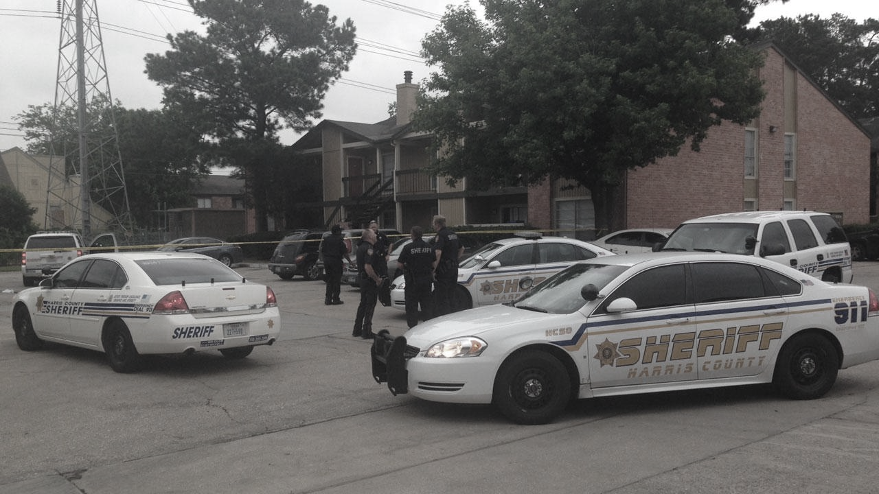
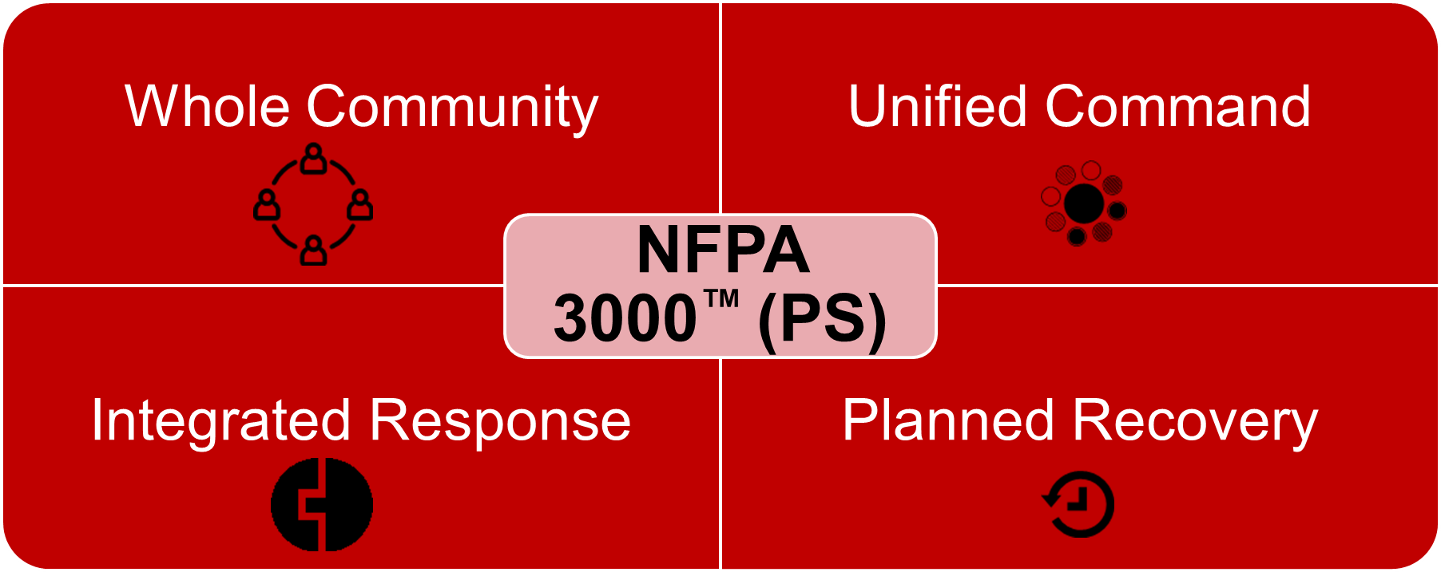
FOUR PRIMARY COMPONENTS
SINGLE SET OF REQUIREMENTS
Whole community addressing unified command, integrated response, and planned recovery
Notes:
Unified Command - How and why the unified command structure at an operations level needs to be in place, practiced, and physically in the same location.
Integrated Response - Preparation and response must take into account the operations of numerous different agencies. These organizations must have operational plans that incorporate the objectives of other responding agencies and they must function as a cohesive, integrated unit.
Recovery - Effective recovery planning must start now, and there are several aspects of recovery (immediate, early, and continued recovery) that need to be planned for.

Slide 8
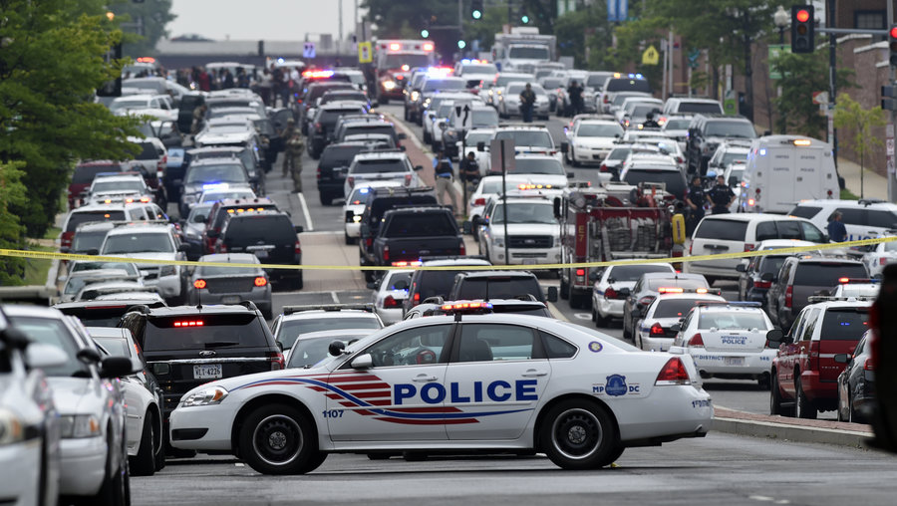
LESSONS LEARNED
FROM RECENT ACTIVE SHOOTER INCIDENTS
HISTORY REPEATS ITSELF ENDLESSLY FOR THOSE WHO ARE UNWILLING TO LEARN FROM THE PAST.
-LEON BROWN
Notes:
Lessons Learned from Active Shooter incidents

Slide 10
PULSE NIGHTCLUB|ORLANDO, FLORIDA
“As soon as possible and practical…establish a unified command of all primary first responders...”
TOTAL SHOT
“…greater coordination at the scene and citywide.”
Uncoordinated self-deployment placed some officers in danger...”
“…direct personnel and resources to staging areas to coordinate assignments, and ensure adequate ingress and egress are maintained.”
“Uncoordinated self deployment...presents officer safety challenges…”
“…prevent uncoordinated and inefficient self-deployment.”
102
“…additional personnel should be directed to staging areas…”
KILLED
49
“Uncoordinated self-deployment placed some officers in danger inside Pulse as well as outside from improvised explosive devices. In addition, as evidenced by multisite attacks in Paris and Mumbai as well as attacks in the United Kingdom in the summer of 2017, police departments must be prepared to deploy and respond to multiple locations and coordinated attacks.”
“After adequate personnel are on scene, additional personnel should be directed to staging areas for assignment of duties and should be directed to return to the staging area prior to their dismissal, or return to their regular assignment after being relieved.”
“Uncoordinated self-deployment, particularly in instances of mass public violence and or a terrorist attack, presents officer safety challenges and depletes resources that may be needed to respond to secondary attacks or regular calls for service.”
“As soon as practical a supervisor should be designated as the scene safety officer to direct personnel and resources to staging areas, coordinate assignments, and ensure that adequate ingress and egress are maintained.”
INJURED
“As soon as possible and practical during an incident, establish a unified command of all primary first responders – including fire and EMS – to facilitate communication, situational awareness, operational coordination, allocation of resources, and delivery of services”
“Law enforcement supervisors must anticipate and train to prevent uncoordinated and inefficient self-deployment.”
“The self-deployment of approximately 300 Orlando area law enforcement personnel needed greater coordination at the scene and citywide.”
53
OFFICERS
300
Rescue, Response, and Resilience: A Critical Incident Review of the Orlando Public Safety Response to the Attack on the Pulse Nightclub.
Washington, DC: Office of Community Oriented Policing Services.

Slide 11
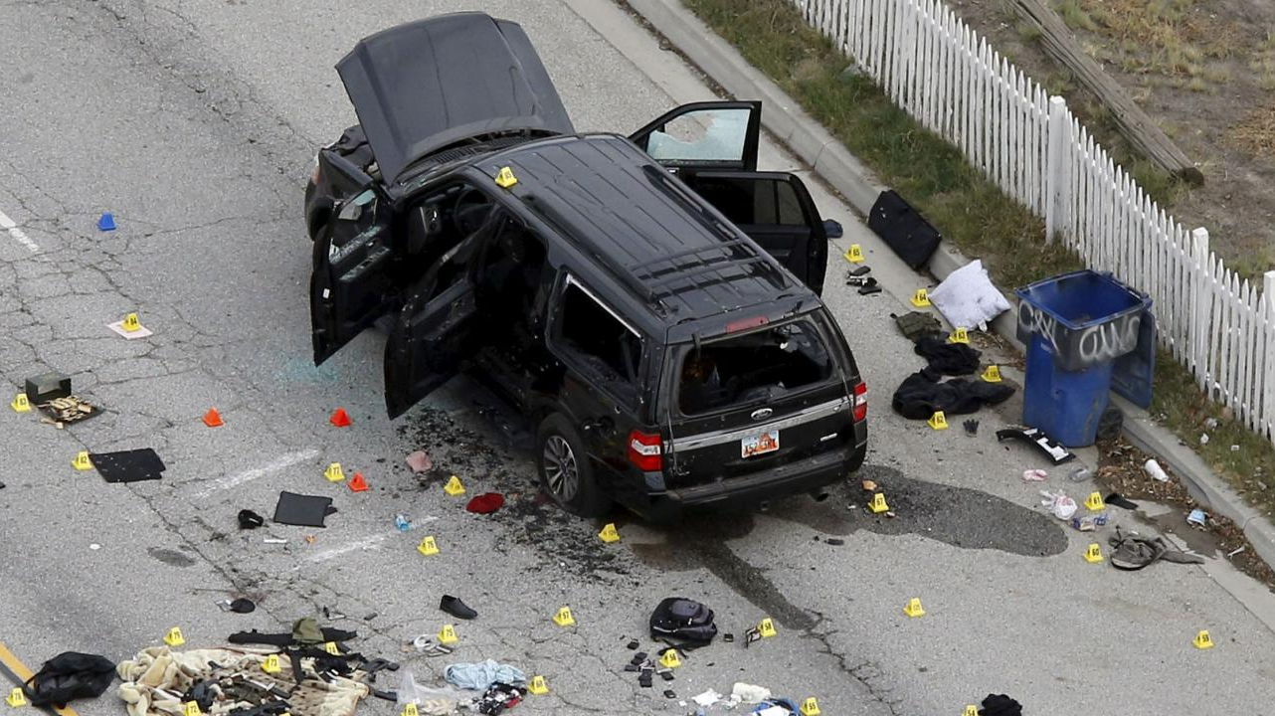

Slide 12
TERRORIST ATTACK|SAN BERNARDINO, CALIFORNIA
TOTAL SHOT
“As soon as possible and practical during an incident, establish a unified command of all primary first responders…”
“…designating a staging area manager is critical during the early moments of the response.”
Traffic congestion from officers abandoning vehicles in the roadway, made it difficult for EMS to transport victims.
36
“Agencies must continually plan and evaluate ingress and egress routes during critical incidents.”
KILLED
14
Agencies must continually plan and evaluate ingress and egress routes during critical incidents. An incident safety officer should be designated as quickly as possible and pay particular attention to the access or egress of emergency vehicles.
In the San Bernardino response, as the number of law enforcement officers responding grew, so did traffic congestion caused by officers abandoning their vehicles in the roadway without consideration of the effects on the need for ingress or egress.
As soon as possible and practical during an incident, establish a unified command of all primary first responders to facilitate communication, situational awareness, operational coordination, allocation of resources, and delivery of services.
After adequate personnel are on scene, additional personnel should be directed to staging areas for assignment of duties. As described in a variety of NIMS courses, designating a staging area manager is critical during the early moments of the response.
INJURED
22
OFFICERS
175
Bringing Calm to Chaos: A Critical Incident Review of the San Bernardino Public Safety Response to the December 2, 2015, Terrorist Shooting Incident at the Inland Regional Center. Critical Response Initiative. Washington, DC: Office of Community Oriented Policing Services.

Slide 13
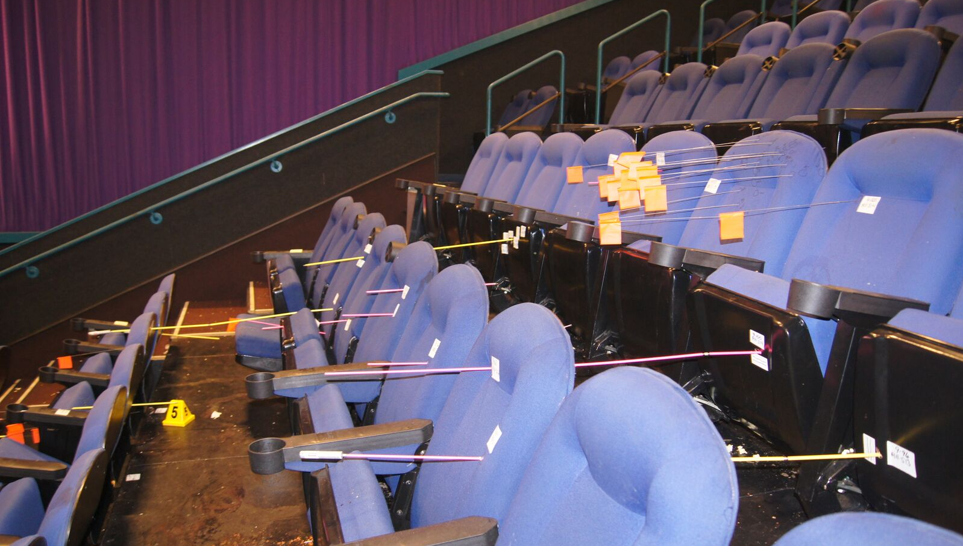

Slide 14
THEATER SHOOTING|AURORA, COLORADO
TOTAL SHOT
70
55
52
52
KILLED
12
34
INJURED
58
10
14
6
OFFICERS
160
Aurora Century 16 Theater Shooting, After Action Report for the City of Aurora

Slide 15
THEATER SHOOTING|AURORA, COLORADO
TOTAL SHOT
Operating a single incident command post would greatly enhance inter-agency communications.
Had Unified Command been immediately established, several challenges could have been mitigated.
70
Unified command was not established until late in the first hour. Having a UC might have resolved major communications issues.
Keep paths open for ambulances.
Stage mutual aid assistance forces when their help is not needed for the active shooting portion of the incident.
KILLED
12
Having the senior police and fire command personnel operating at a single incident command post would greatly enhance inter-agency communications. It would have also facilitated activation of basic EMS system components, coordinated requests for additional resources, and limited the filtering out of some police-fire messages going through the dispatch center.
A single (Police and Fire) command post was not immediately established. If the ranking officers from police and fire immediately established a single Incident Command Post (ICP), then several challenges could have immediately been mitigated.
These include:
Immediate communications between senior police and fire officials
Coordination of the requests for additional resources
Clear establishment and communication of incident safety zones
Coordination of incident intelligence concerning additional active shooters, threats to emergency personnel, and rumor control
Police and fire officials did not establish a unified (joint) command nor a single overall commander until late in the first hour of the incident. Having a unified command might have resolved police-fire communications issues regarding getting ambulances in closer to victims, and clarifying the level of risk to fire/EMS personnel. This is not to imply that response actions in the first minutes should have been held up until a joint command was established; any such delay could have negatively affected the outcome.
INJURED
Discuss access issues with fire/EMS as they occur. Likewise, fire/EMS should actively seek access routes. It cannot be assumed that if one police car finds a path to a victim, other fire and police units will be able to do so too. Ambulance access should be a high priority task of police and fire incident command.
Assign a staging officer from the primary jurisdiction. The staging officer under NIMS/ICS guidelines may direct specific assignments.
58
OFFICERS
160
Aurora Century 16 Theater Shooting, After Action Report for the City of Aurora

Slide 16
01
02
03
04
LESSONS LEARNED FROM AFTER ACTION REPORTS
LACK OF ACCOUNTABILITY
POOR COMMUNICATION
LACK OF SYSTEMATIC PLANNING
NO MANAGEMENT STRUCTURE
ASK YOURSELF…
DO THESE APPLY TO ANY OF MY INCIDENTS?
DID WE BARELY MAKE IT THROUGH?
WHAT IF WE HAD JUST WORKED TOGETHER?

Slide 17
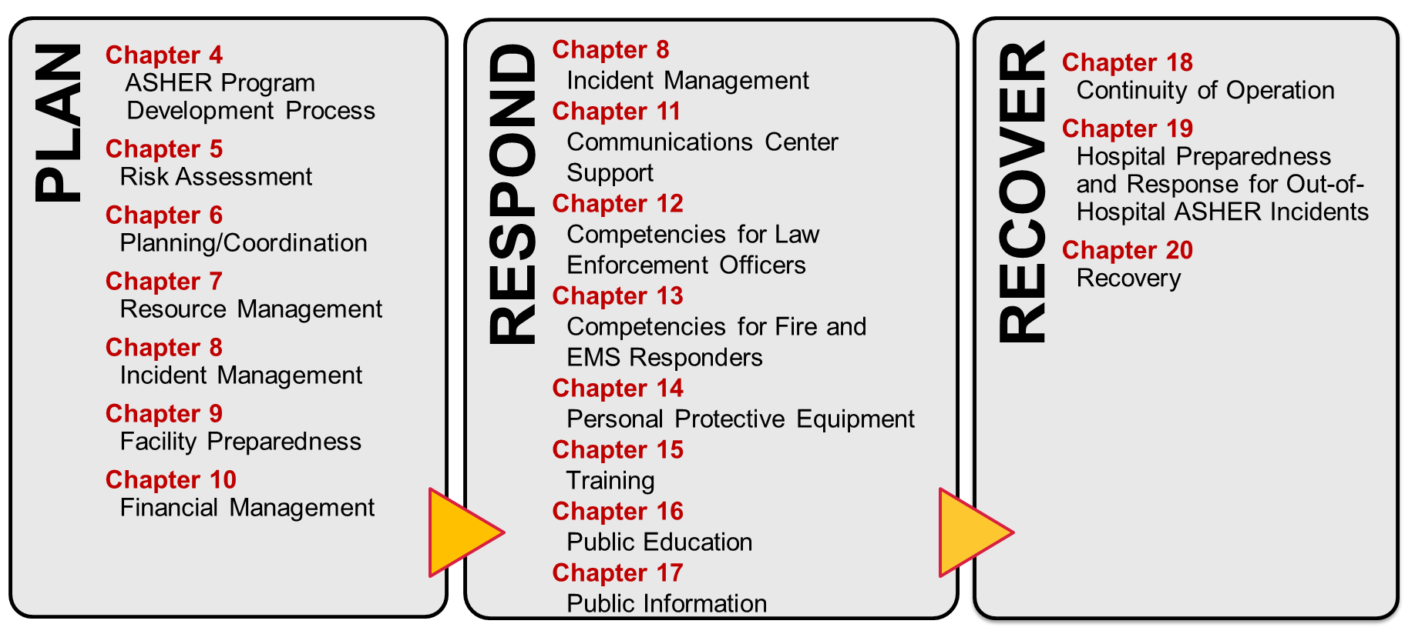
NFPA 3000 Road Map

Slide 18
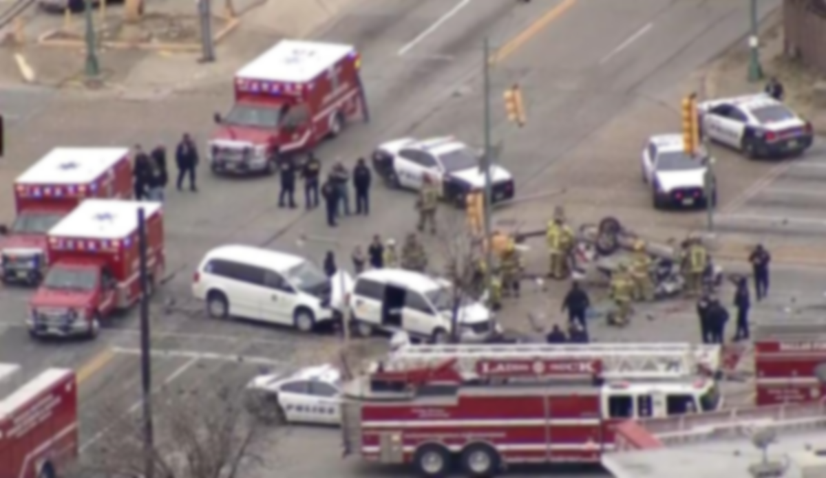
CH 4: ASHER Program Development
PURPOSE
Provides AHJ & Stakeholders with a framework for developing an ASHER Program
SHALL MAINTAIN POLICY THAT ESTABLISHES THE FOLLOWING
Existence of the ASHER Program
Services that the ASHER Program will provide
List of ASHER Program stakeholders
Functions that ASHER Program stakeholders are expected to perform
GUIDANCE
Step by step guidance provided from Ch. 5 - 20

Slide 19
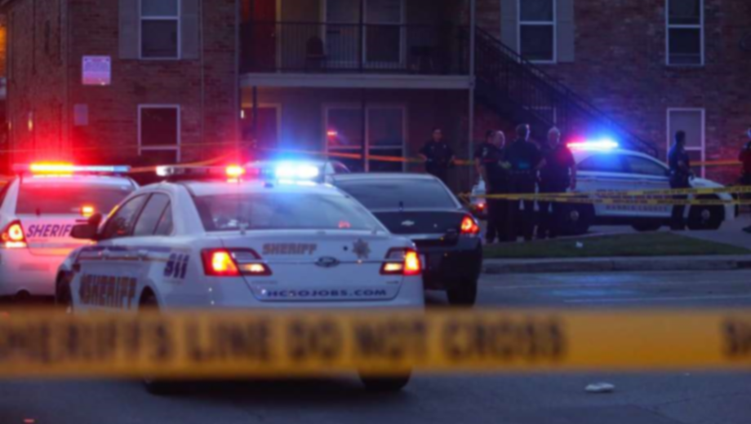
CH 5: ASSESSMENT
TARGET OR AT RISK LOCATIONS
LIST OF ITEMS TO BE CONSIDERED
IDENTIFY THREATS
IDENTIFY RESOURCES
ESTABLISH RELATIONSHIPS
RESOURCES
REALISTIC WORST-CASE SCENARIO FOR IDENTIFIED LOCATIONS
ANALYZE CONSEQUENCES
ONE EVENT TRIGGERS ANOTHER
CONSIDER EACH EVENT SINGULARLY OR COLLECTIVELY
CASCADING INCIDENTS

Slide 20
FIRE
LAW
EMS
CH 8: UNIFIED COMMAND
AGENCY
AGENCY
AGENCY
UNIFIED COMMAND
Incident Size-Up
OPERATIONS
Establish Unified Command
SECTION CHIEF
Transfer Command
Tactical Decisions
RESOURCES
Incident Stabilization

Slide 21
CH 6: Facility Readiness
SETS MINIMUM REQUIREMENTS
Design, operation, and maintenance of buildings and occupancies for safety to life from active shooter / hostile event
ACTIVE SHOOTER/HOSTILE EVENT ANNEX
Will be required of all facilities per NFPA 101, Life Safety Code
Will be required to drill annually
NOTIFICATION & EXERCISE
Notification process or system should be designed as to not confuse it with the fire alarm signal
Building owners and operations must annually exercise their procedures
Annual exercise should involve different portions of the structure each year

Slide 22
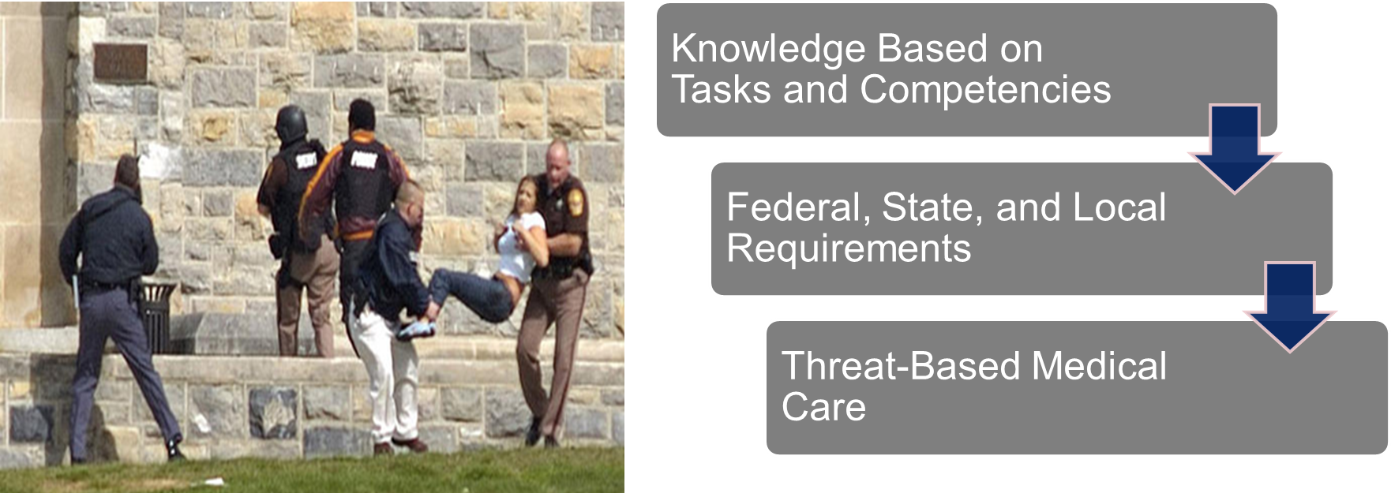
CH 12: RESPONDER COMPETENCIES
LAW
Provide law enforcement officers who, in the course of duties, may encounter ASHER incidents with the knowledge and skills to respond effectively and efficiently in an integrated manner.
AGENCY

Slide 23
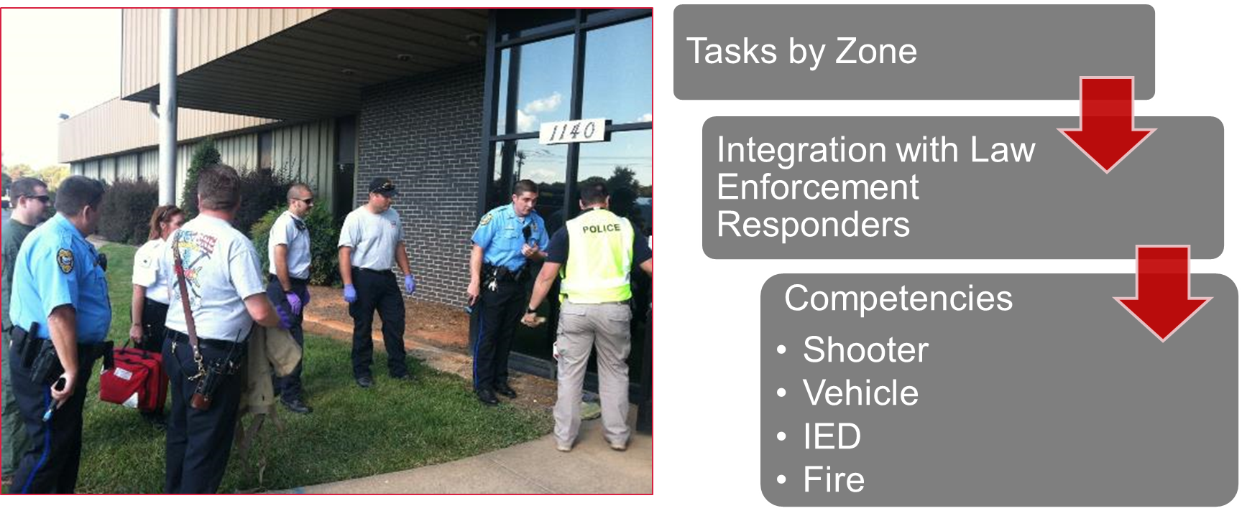
CH 13: RESPONDER COMPETENCIES
FIRE
EMS
To provide fire and EMS personnel who in the course of duties could encounter ASHER incidents with the knowledge and skills to respond effectively and efficiently in an integrated manner.
AGENCY
AGENCY

Slide 24
CH 14: PERSONAL PROTECTIVE EQUIPMENT
Fire and EMS vests for warm and hot zone are required but what does that mean?
It means that if you are in those zones you need to wear the vest.
However, the committee understands that it is impossible for this to happen tomorrow.
There is a provision in the standard that empowers the incident commander to send personnel into those zones without vests for the purpose of saving a life – but it will need to be investigated and reported in the after action.

Slide 25
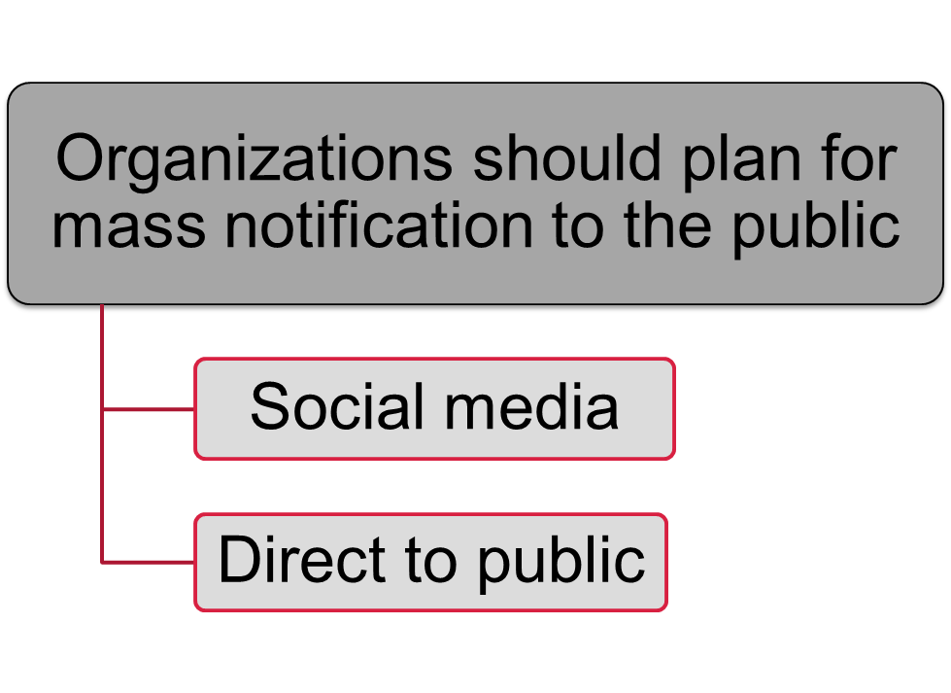
CH 17: PUBLIC INFORMATION
SETS MINIMUM REQUIREMENTS
ASHER Program participants are disseminating information to the public as part of the joint information center and joint information system
IDENTIFIES FOLLOWING MEANS OF COMMUNICATION
Social Media – stating it should be monitored as much as possible
Direct to Public – identify the need for mass notification system

Slide 26
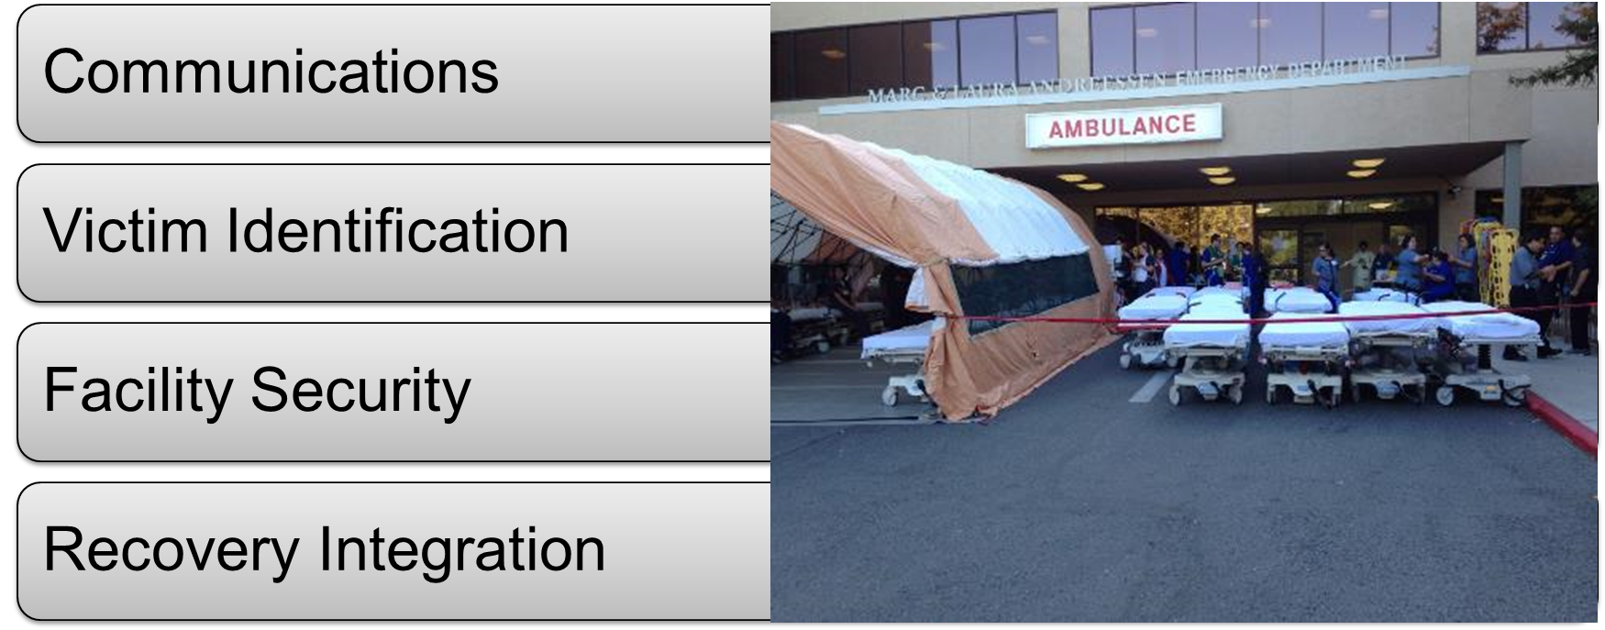
CH 19: HOSPITAL PREPAREDNESS
PURPOSE: Provide information and processes necessary to quickly and efficiently utilize a systematic approach to receiving of patients
HOSPITAL EMERGENCY ACTION PLANS
What they don’t have is a plan for receiving of these patients from an event not at their facility.
Committee felt very strongly that there needed to be a plan out there for how to do that.

Slide 27
CH 20: RECOVERY
PURPOSE: Process necessary to respond to quickly changing priorities and conditions

Slide 28
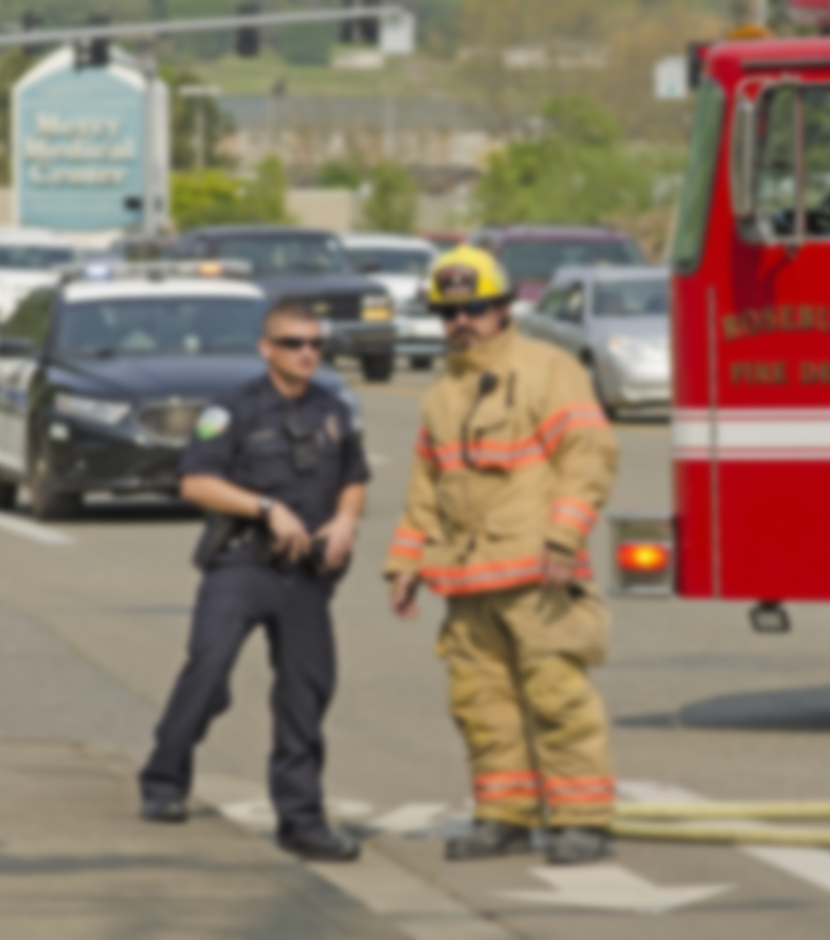
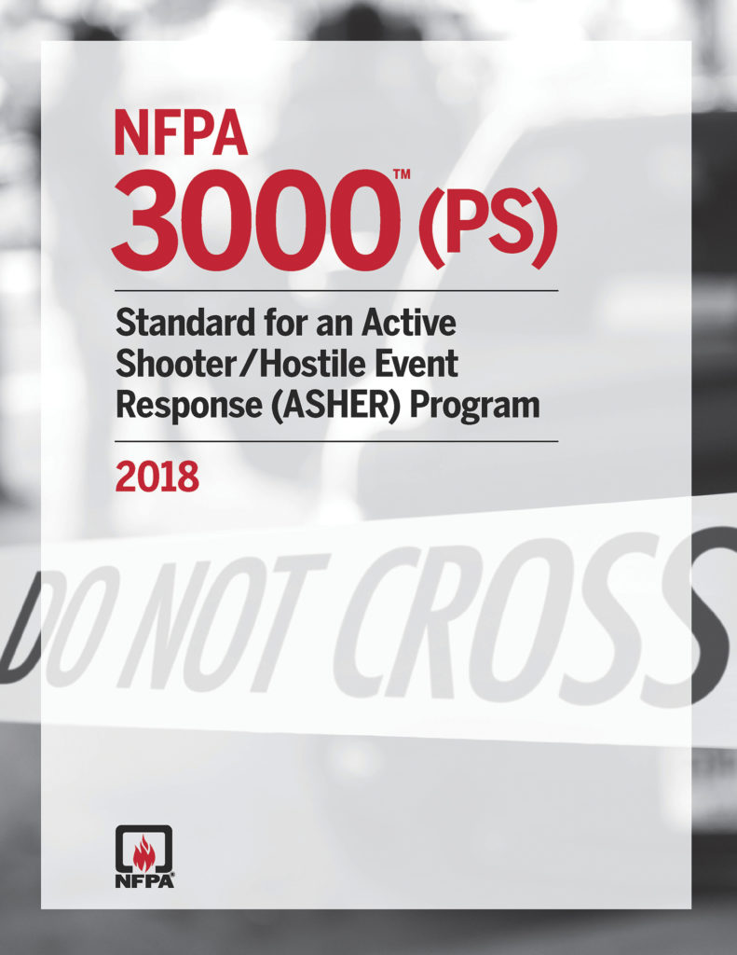
NFPA 3000 SETS -
MULTI-AGENCY ROADMAP, REGARDLESS OF JURISIDICTIONAL SIZE
UNBIASED DOCUMENT TO OPEN CROSS-FUNCTIONAL COMMUNICATION
ENGAGING DOCUMENT FOR THE ROLE OF EMERGENCY MANAGEMENT
TOOL TO OVERCOME P.P.E.
(PERSONALITIES, POLITICS, AND EGOS)

Slide 29
Questions
QUESTIONS

Slide 30
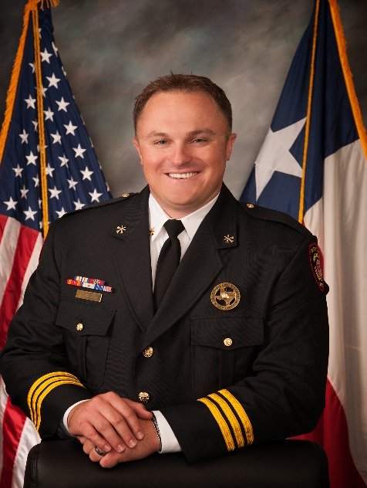
Presenter Information
RODNEY REED
ASSISTANT CHIEF, HCFMO
RODNEY.REED@FMO.HCTX.NET
713-274-1717

